Slide 1
Module 1: Overview of geospatial analysis
Michael Otterstatter, PhD
Analytic Capacity Building Initiative: Workshop in Geospatial Methods
September 17-18, 2019, Calgary, Alberta

Slide 2
Outline
Background and concepts
geospatial analysis in public health
why do we need geospatial analysis?
review of selected terms and concepts
Discussion
geospatial analysis and public health decision making
Illustrative example
References and other resources

Slide 3
Background and concepts

Slide 4

Geospatial analysis in public health
Background and concepts
A foundation of epidemiology and public health is the identification and analysis of disease patterns in populations in terms of person, place and time, in order to:
track diseases
detect changes and outbreaks
evaluate interventions and services
prevent and control disease

Slide 5

Geospatial analysis in public health
Background and concepts
The key element of place identifies where a health event of interest occurred
Geospatial analysis* is the set of methods and tools we use to describe and understand patterns in the location of health events
* sometimes referred to as geographical epidemiology, spatial epidemiology, medical geography

Slide 6
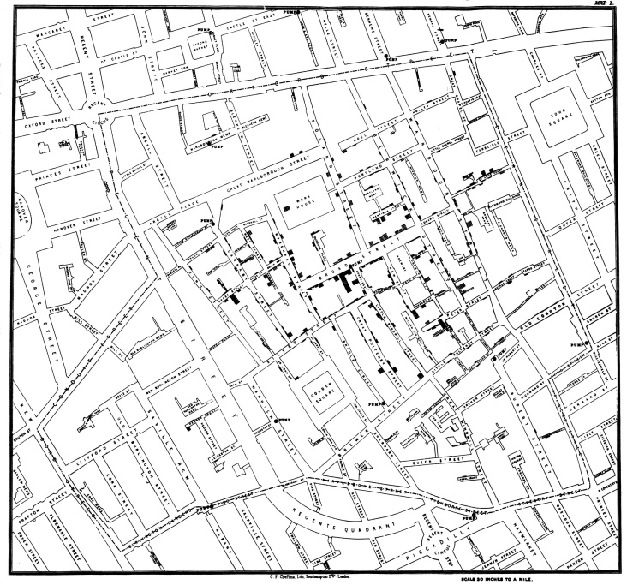

Geospatial analysis in public health
Background and concepts
The mapping of health events has a long history in epidemiology, going back at least as far as John Snow’s mapping of cholera cases in London during the 1850s
https://upload.wikimedia.org/wikipedia/commons/2/27/Snow-cholera-map-1.jpg

Slide 7
Geospatial analysis in public health
Background and concepts
Modern applications in public health continue to include mapping of disease cases, but also aim to
evaluate differences in health services and health-related rates/risk across different geographic areas
quantify uncertainty in spatial measures/maps
identify “clusters” of disease or other health events of interest
assess the significance of factors potentially related to disease occurrence (e.g., exposures, services, etc.)

Slide 8
Why do we need geospatial analysis?
Background and concepts
In public health, we often observe that measures from neighbouring regions are related (e.g., all tend to have high values, or low values) – consider Tobler’s (1970) first law of geography,
“Everything is related to everything else, but near things are more related than far things”
For accurate and reliable estimates, geospatial analysis must take proper account of this spatial dependency (non-independence) among measures

Slide 9
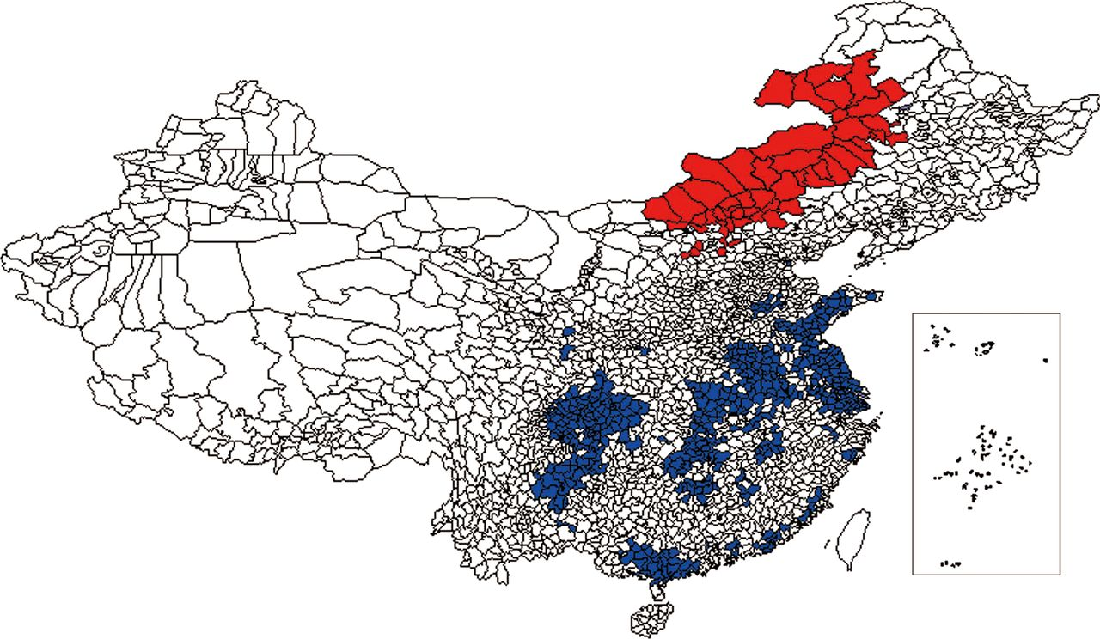
Why do we need geospatial analysis?
Background and concepts
Yet, we also observe that rates of disease often differ across locations
Spatial analysis can provide a better understanding of how and why disease varies by location, which ultimately can help inform disease prevention and control
Also, note that much of the data collected in public health has some record of location – this is important information that should be included in our analyses!

Slide 10

Considerations and cautions
Background and concepts
Many considerations must be made when conducting geospatial analysis, including
requirements, access, use and quality of data*
privacy and confidentiality
historical artifacts
appropriate analytic methodology
statistical assumptions
interpretational challenges
appropriate dissemination
Note that not all of these are covered here and that consultation with experts (e.g., medical geographer) should be standard practice
*Geospatial analysis suffers from the 4 “in’s”: data requirements are intensive, but the data themselves may be inaccessible, inaccurate, and incomplete (Albert et al., 2000)

Slide 11
Review of selected terms and concepts
Background and concepts
For your reference, see the following sources for terminology and concepts related to spatial analysis:
https://support.esri.com/en/other-resources/gis-dictionary
https://gisgeography.com/gis-dictionary-definition-glossary/
https://www150.statcan.gc.ca/n1/pub/92-195-x/92-195-x2011001-eng.htm

Slide 12
Discussion

Slide 13

Spatial analysis in public health
Discussion
How can spatial analyses inform public health decisions?
Informing service distribution, based on population characteristics, density, health care needs; or, identifying closest appropriate service for underserved communities
Measuring and evaluating distance and time to health care facilities for key populations (e.g., elderly, homeless, etc.) – straight line, relative, road network distances – to understand needs and gaps
Surveillance and monitoring of health events, including disease incidence, deaths, immunization coverage, and their longitudinal trends, by geographic regions to inform investigation and action

Slide 14
Illustrative example

Slide 15
Geospatial analysis in R
Illustrative example
Here, our focus is the application of geospatial methods using R software
NO₂ concentrations in Europe as a public health example

Slide 16
References and resources
Albert, D.P., Gesler, W.M. and Levergood, B. eds. 2003. Spatial analysis, GIS and remote sensing: applications in the health sciences. CRC Press
Tobler W. 1970. A computer movie simulating urban growth in the Detroit region. Economic Geography, 46(Supplement): 234–240.
Waller, L.A. and Gotway, C.A. 2004. Applied spatial statistics for public health data. John Wiley & Sons.

